Slide 1
I Com Arm - Kneecap

Slide 2
Organisation du diapo

Slide 3
What about ?
This system is very use by handicapped people, who need a articulate arm for their chair.
Indeed, fixed to a handle, it allow to change the position of some steering device.

Slide 4
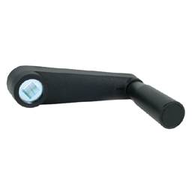
Goal :
Design a system for manual locking

Slide 5
Specifications
No tool is needed for block the system.
Tightening should be possible with only one hand
The same system could be used for the locking of clamps on the chair

Slide 6
Our project :
History :
19/11/12 : The first idea we have was to make a saddle (selle) of bike.
After, we have stop our choice on a handle
with a nut at the base. Only one to be able to change with top or bottom

